Slide 1
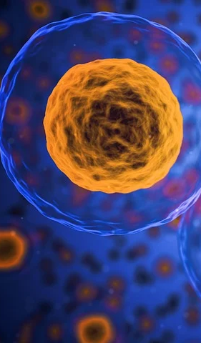
Gaining insight on human early organogenesis through
TRA expression analysis

Slide 2





Structure
Background
Quality control
Hypothesis
Take home message

Slide 3


Background

Slide 4
Embryogenesis
Brain
Important steps:
neuronal proliferation and differentiation (starting at week 4)
neuronal migration and synapse formation (starting at week 9)
Entwicklungs-und Reproduktionsbiologie, Müller 2018
Notes:
And those tissues develop during Embrygenesis.
The whole process starts with the fertilization of an egg by sperm.
As a result, the fertilized egg gets into a process of rapid cell devisions, which led to the creation of the Blastula.
The three germ layers ectoderm, mesoderm and endoderm are created during Gastrulation.
Neurodermal tissues from the ectoderm differentiate to the neuronal plate. The neuronal plate closes and creates the neuronal tube.

Slide 5
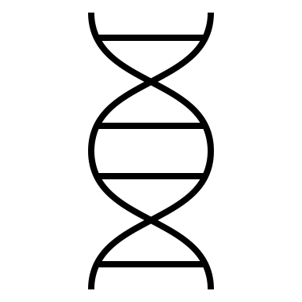
Quality control

Slide 6
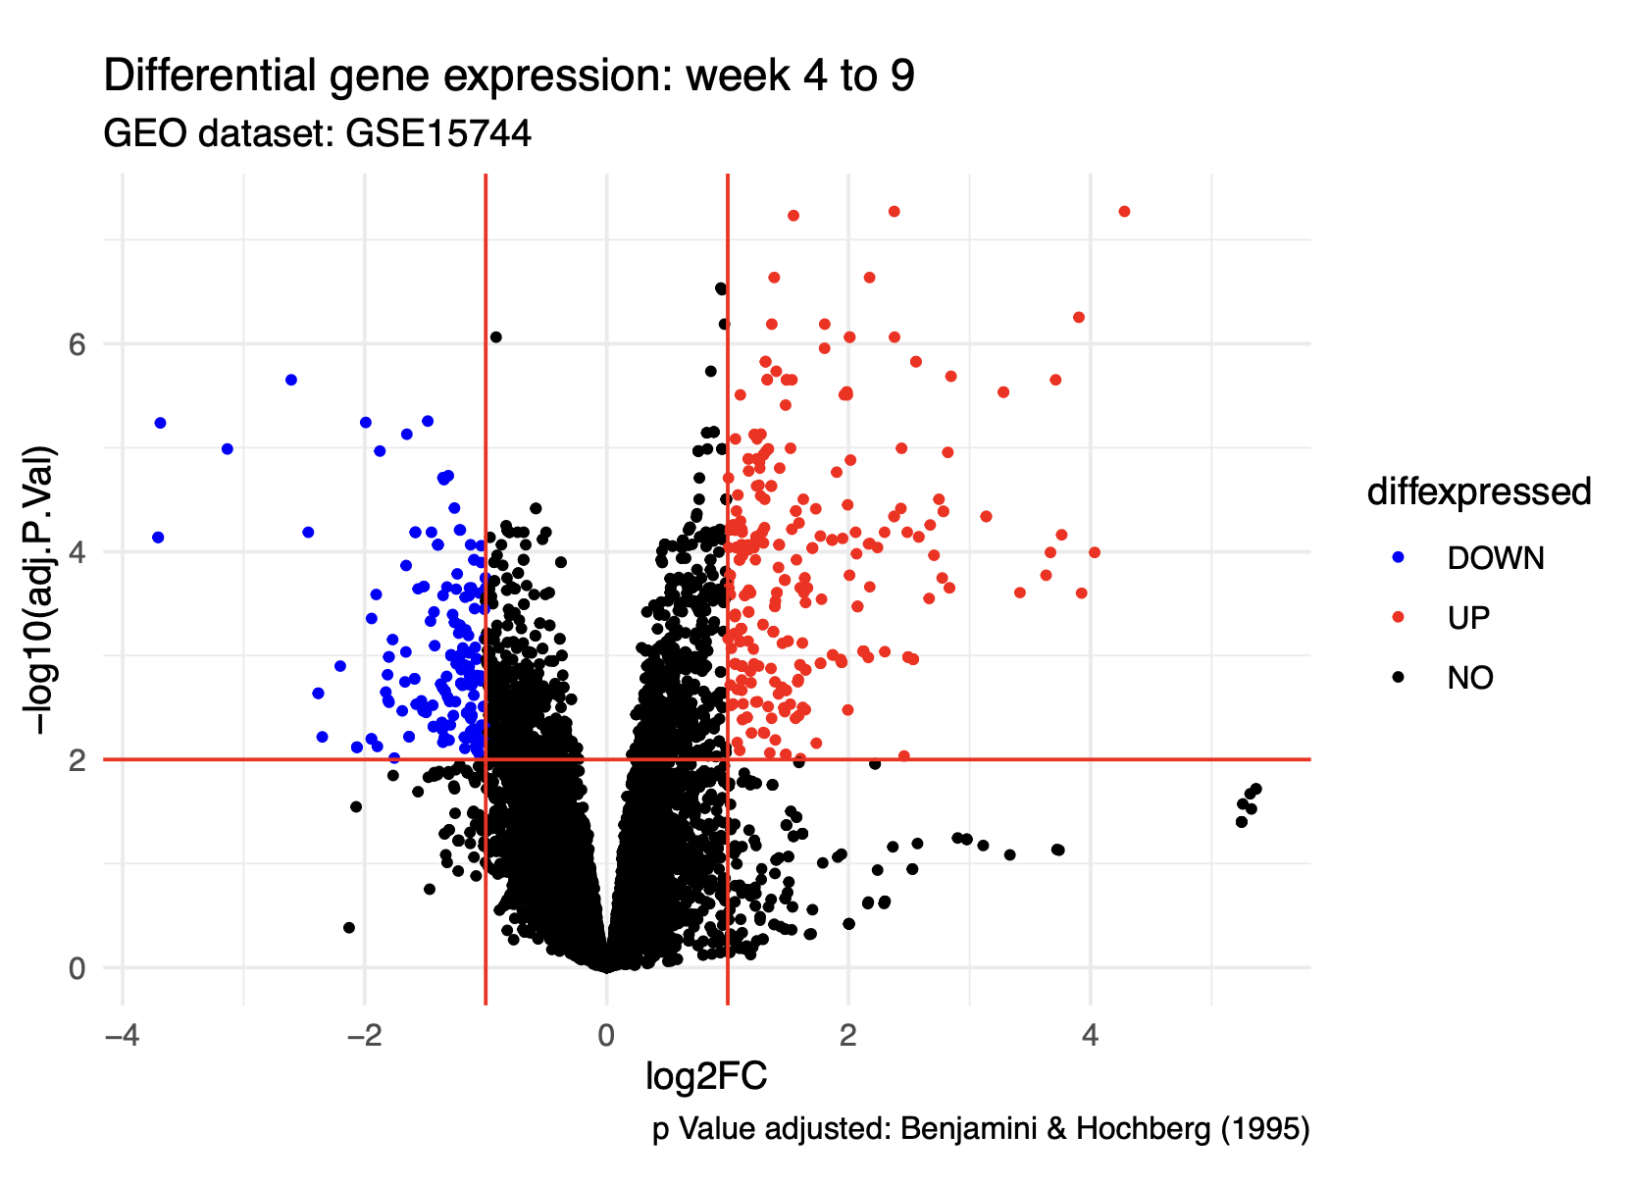
Quality control

Slide 7
Hypothesis

Slide 8
Hypothesis
Brain subtissue-specific gene expression reflects neuronal development processes

Slide 9
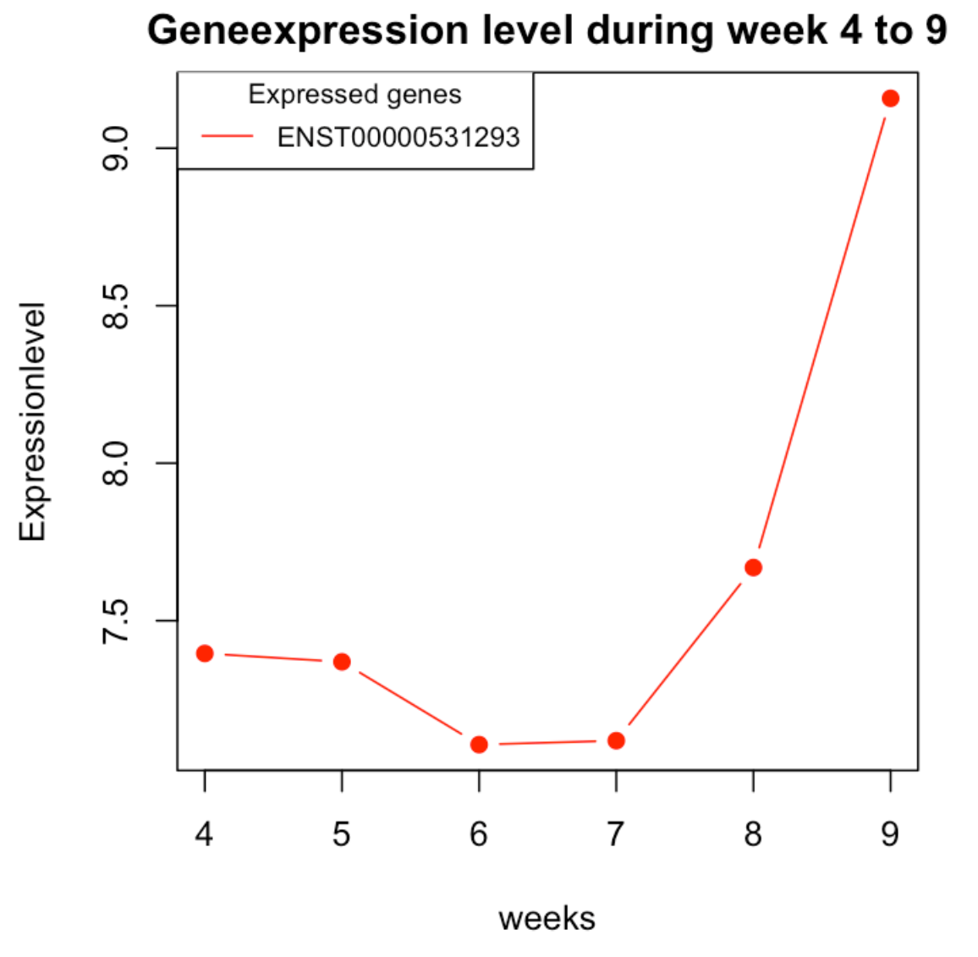
Ion channels
SLN sarcolipin
(Sarcoplasmic reticulum Ca(2+)-ATPases)
neuronal migration starting week 9

Slide 10
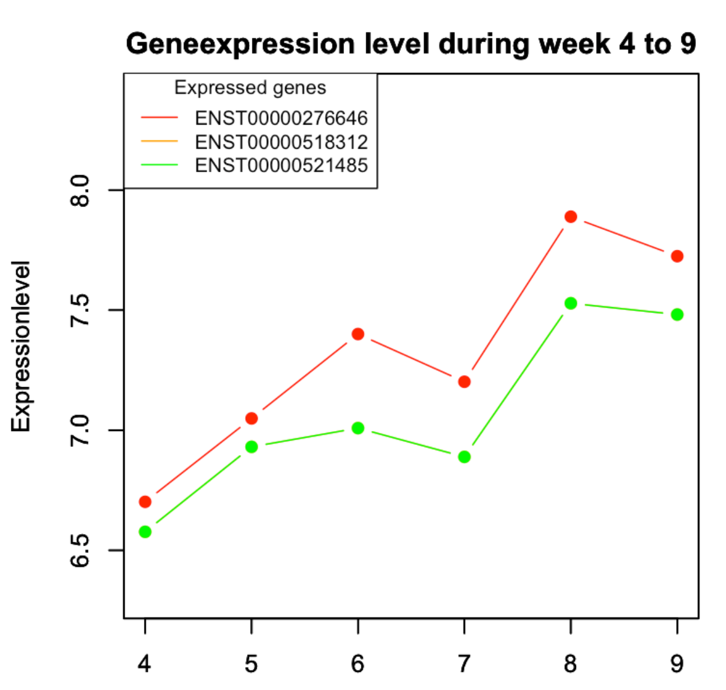
Neuronal development and function
SYBU (syntabulin)
SNAP91 (synaptosome associated protein 91)
Endocytosis
ENST00000518312 and ENST00000521485 have identical correlation

Slide 11
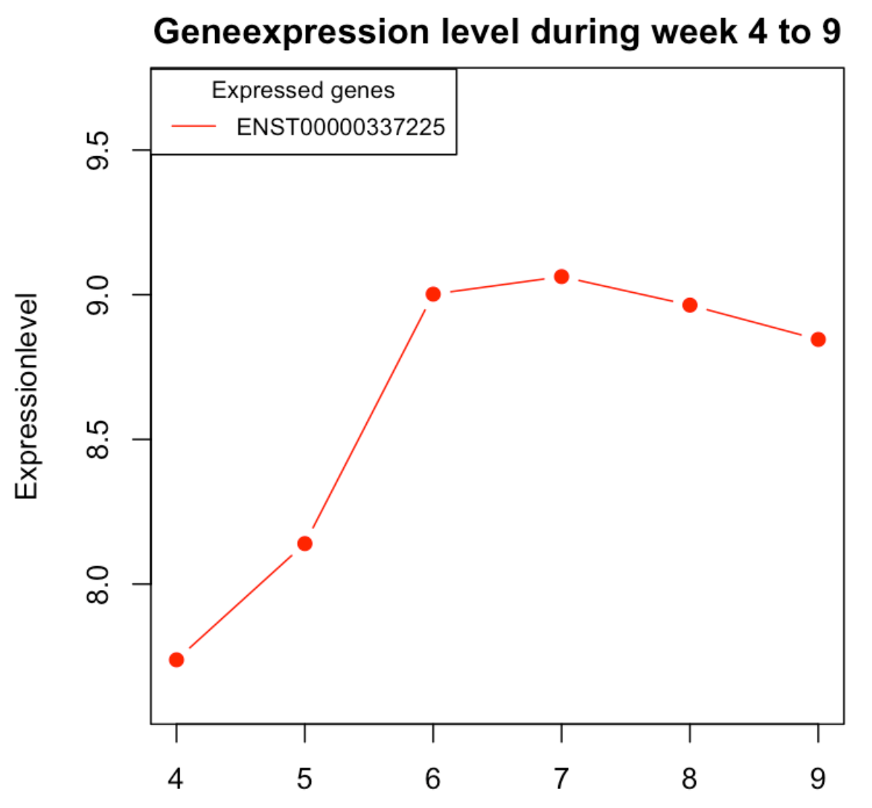
Chemokins
CXCL14 (C-X-C motif chemokine ligand 14)
neuronal migration starting week 9

Slide 12
Take home message

Slide 13
Take home message
TRA can help us to understand molecular biological processes in early organogenesis
Notes:
Now that we have taken an in depth look at what we have achieved so far, lets switch our perspective around and take a look at where we want to go and what we want to achieve in the next two month.
Starting from today until the 31st of this month we are in phase one of our project: Differential gene expression. We are going to implement methods such as limma analysis and t-tests to further explore our data set and determine differentially expressed genes that will be of interest to us.
In Phase two, we will further analyze these genes of interest. We will do that by screening them for expression patterns using Methods like principal component analysis and k-means clustering. Optionally, we will also start exploring chemokines if there will be enough time for it. This second phase will end on the 14th of July. In Phase three, until the 28th of July we will start with the in depth evaluation of our found data. We plan on connecting our findings with the biological background and doing more research based on our findings. Phase four will be used to explore any new questions and ideas that will come up during the process of our project. We wil use this time to follow our research curiosity and personal interests. This will be going on until the 5th of July. Phase five will be used to take all necessary steps to conclude this project. We will compile all relevant data into a report and prepare a final presentation. This will be used to present all our gained knowledge to you. This last Phase will end on the 19th of July, just one day before we will conclude this project by holding our final presentation.

Slide 14
Gaining insight on human early organogenesis through
TRA expression analysis

Slide 15


Appendix

